Slide 1

Can I Land Here?
A Legal View of Aeronautical Decision Making
Dave Bair
Feb 28. 2026

Slide 2
Can I Should I Land Here?
A Legal View of Aeronautical Decision Making
Dave Bair

Slide 3
Your phone rings.
Notes:
Pause before speaking.
Let the room settle.
Say slowly:
"Hey Dave… the sheriff is here to see you."
This is how the story starts — not at launch.
Set the tone that this talk is about consequences, not just technique.

Slide 4
“The sheriff is here to see you.”

Slide 5
Today’s Agenda
Priorities for Landing
Legality of Operations
Improving Your “Legality”
Choose Your Risk

Slide 6
Landing Priorities
Safety
Damage
Accessible
Aesthetic

Slide 7
LEGAL

Slide 8
Where does "legal" fit?

Slide 9
Landing Priorities
Legal ➔
Legal ➔
Legal ➔
Legal ➔
Legal ➔
Safety
Damage
Accessible
Aesthetic

Slide 10
Take-Home #1
“Legal” is a personal opinion
There are too many competing and overlapping laws

Slide 11
July 4th, 2021
Colorado Springs
Lindstrand A160
Paid Ride
1:37 Flight

Slide 12
Green grass. Smart vent. Laydown @12kts.
Notes:
Describe the landing as textbook.
Smooth vent.
Gentle laydown.
Leisurely pack-up.
Make the audience feel how normal it seemed.
Then transition: "Nothing about this felt reckless.

Slide 13
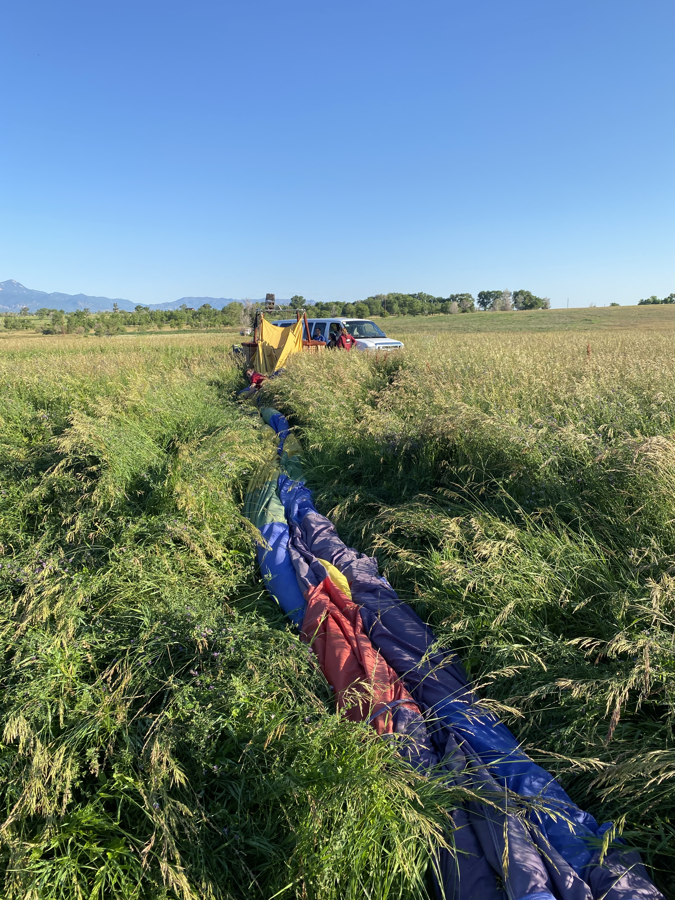
Notes:
Describe the landing as textbook.
Smooth vent.
Gentle laydown.
Leisurely pack-up.
Make the audience feel how normal it seemed.
Then transition: "Nothing about this felt reckless.

Slide 14
An hour later…

Slide 15
“You did $75,000
in damage.”
Notes:
Pause. Let them absorb the number.
Then say:
"For $300 worth of hay."
Explain emotional impact, stress, legal fees, time, and uncertainty.
Emphasize that even reduced lawsuit amounts still cost energy and reputation.

Slide 16
June 29, 2023 $16,995 lawsuit

Slide 17
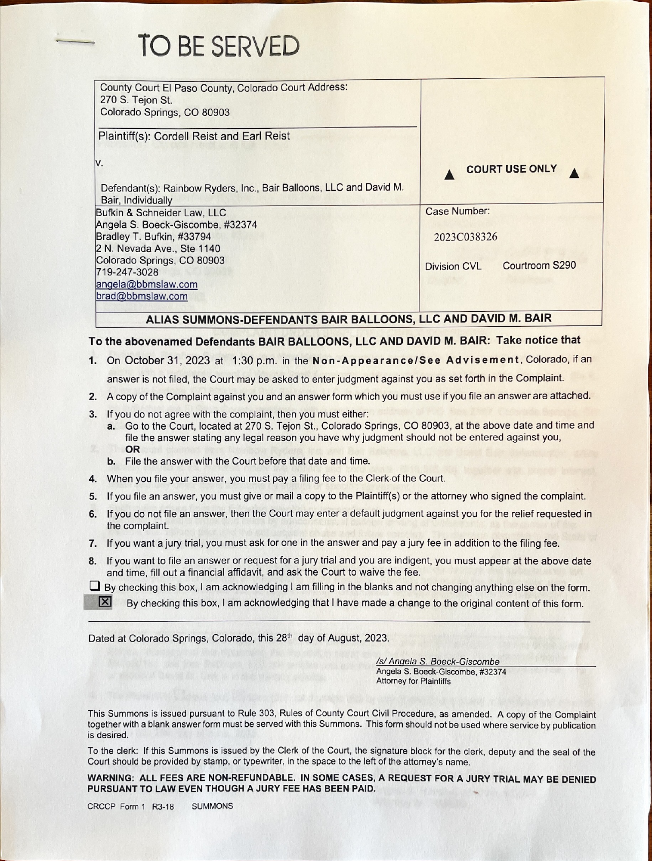
Actual Lawsuit Filed – This Is Real
Notes:
Hold silence for a moment.
Say:
"This is not hypothetical."
"This happened to me."
Explain timeline:
- July 2021 flight
- Served October 2023
Long tail risk.
Decisions follow you.

Slide 18
How do we define a legal landing spot?
Notes:
Ask the room directly.
Was it:
- At launch?
- On final approach?
- When I chose that field?
Then say:
"It began when I decided what I was willing to land in.

Slide 19
“My buddy lands there all the time.”

Slide 20
Past Tolerance

Slide 21
FAA Rules

Slide 22
Public vs. Private Land

Slide 23
It’s not Red on the Fiesta Map

Slide 24
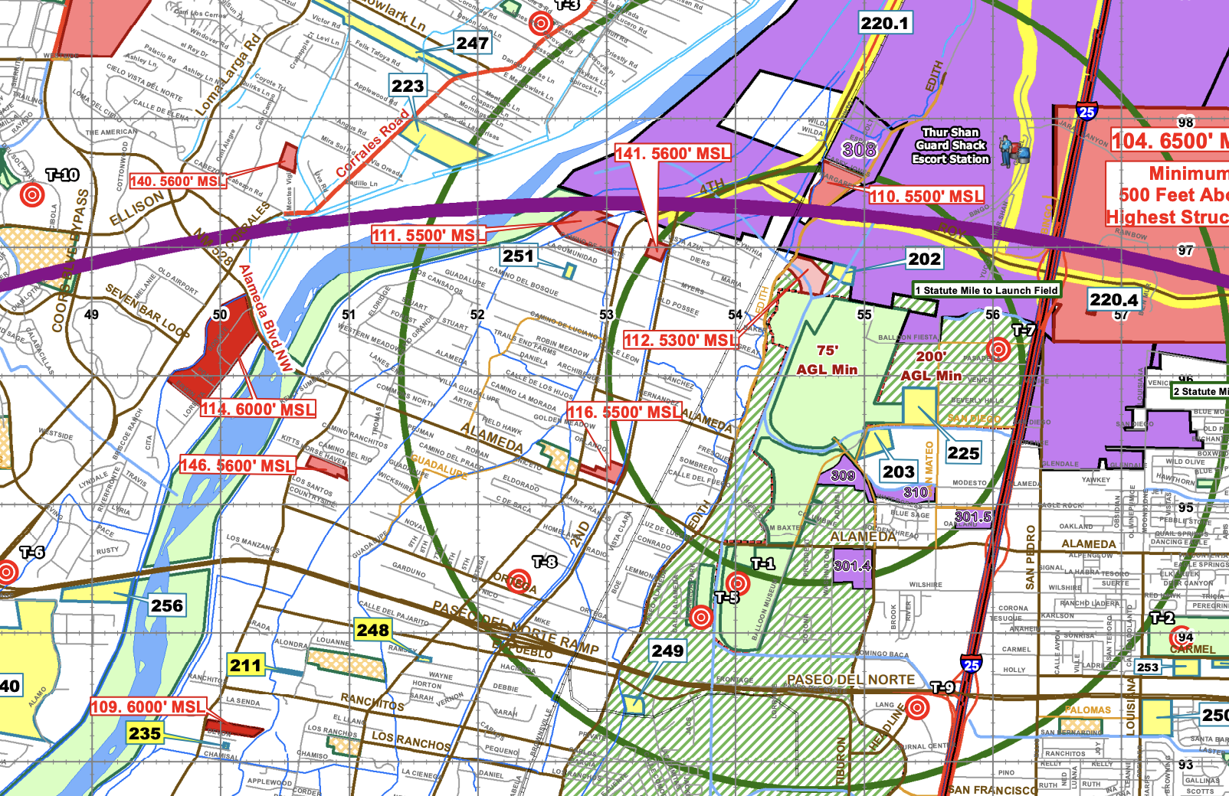

Slide 25
Take-Home #2
“Legal” is in the
eye of the beholder
Anyone can sue you for any reason

Slide 26
Was my landing legal?
Notes:
Ask the room directly.
Was it:
- At launch?
- On final approach?
- When I chose that field?
Then say:
"It began when I decided what I was willing to land in.

Slide 27
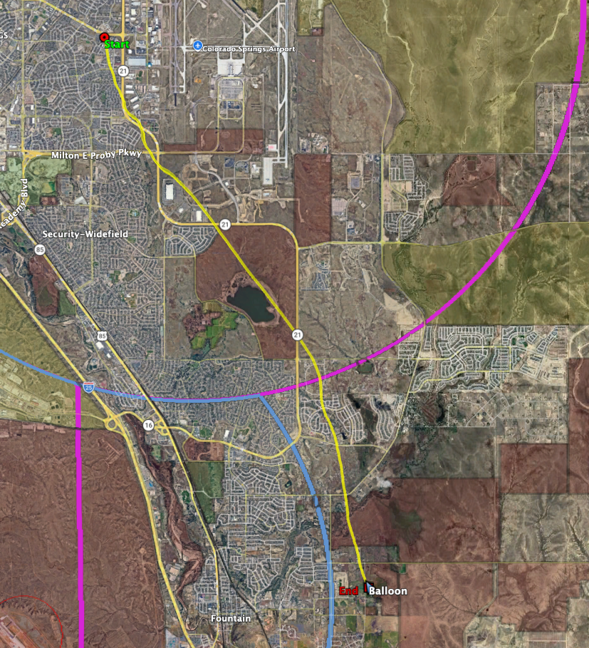
Flight Overview – Start to Landing
Notes:
Point out key red areas on lake,

Slide 28
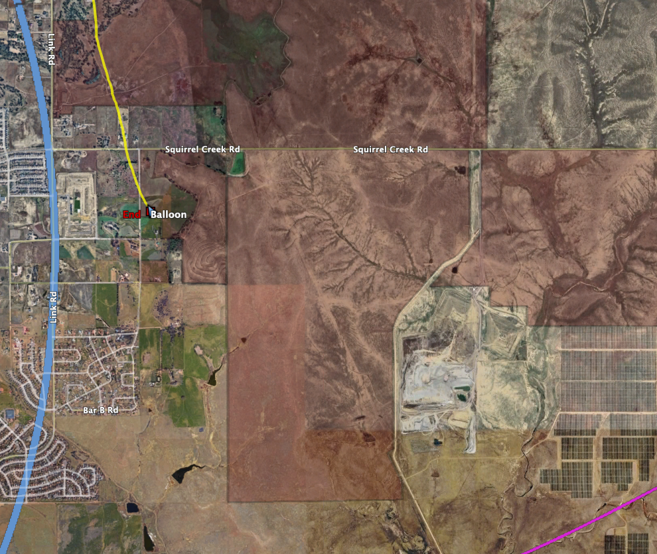
Approach and Wind Line

Slide 29
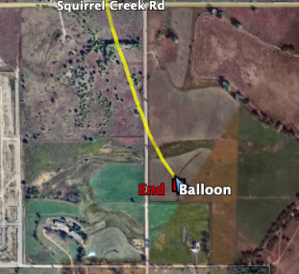
Final Landing Area Detail

Slide 30
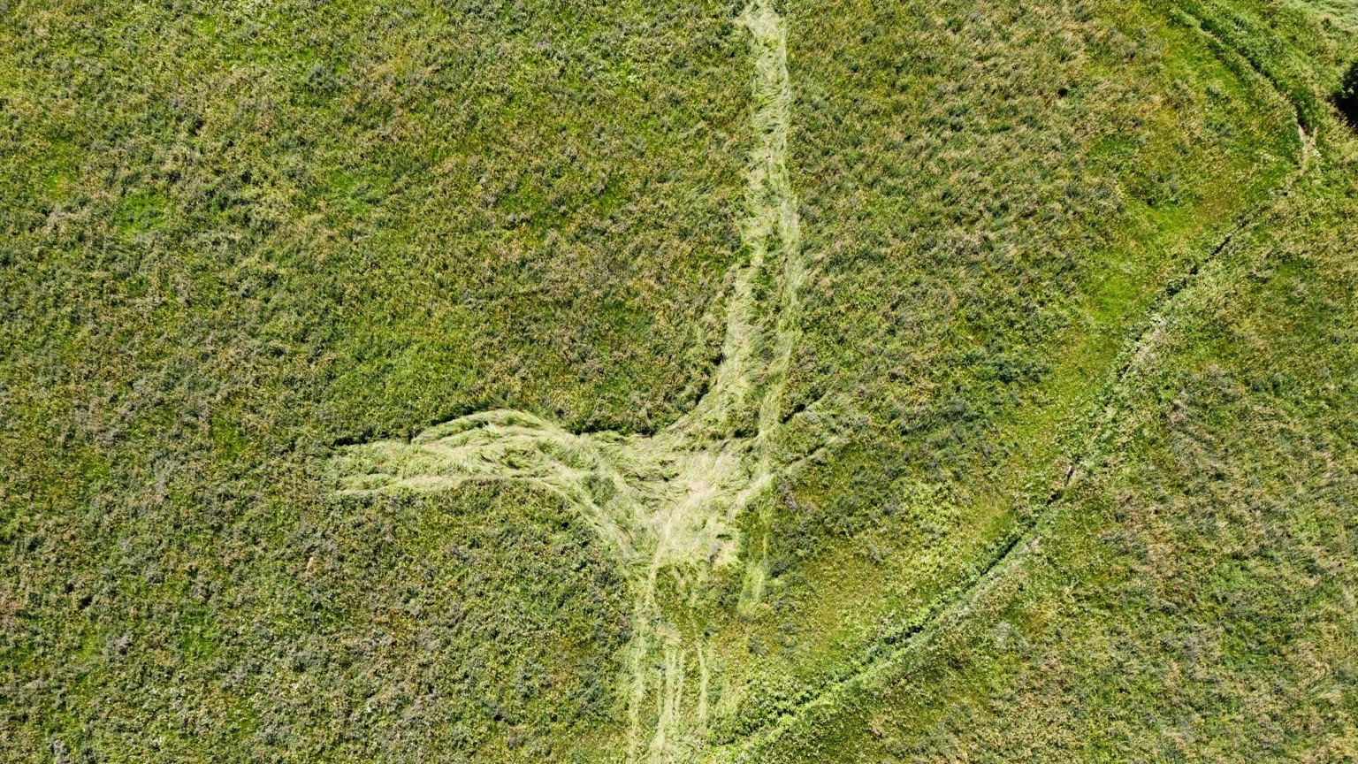
Landing Site – Balloon Packup

Slide 31
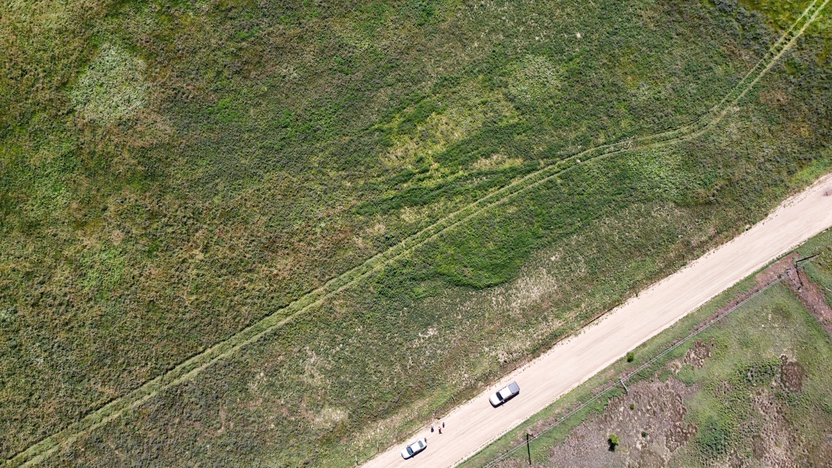
Vehicle Tracks – Access Path

Slide 32
Landing Priorities
Safety
Damage
Accessible
Aesthetic

Slide 33
Take-Home #3
A safe landing buys you time
Injuries create emergency, everything else can wait

Slide 34
Does this even matter?
ABQ is Unique

Slide 35
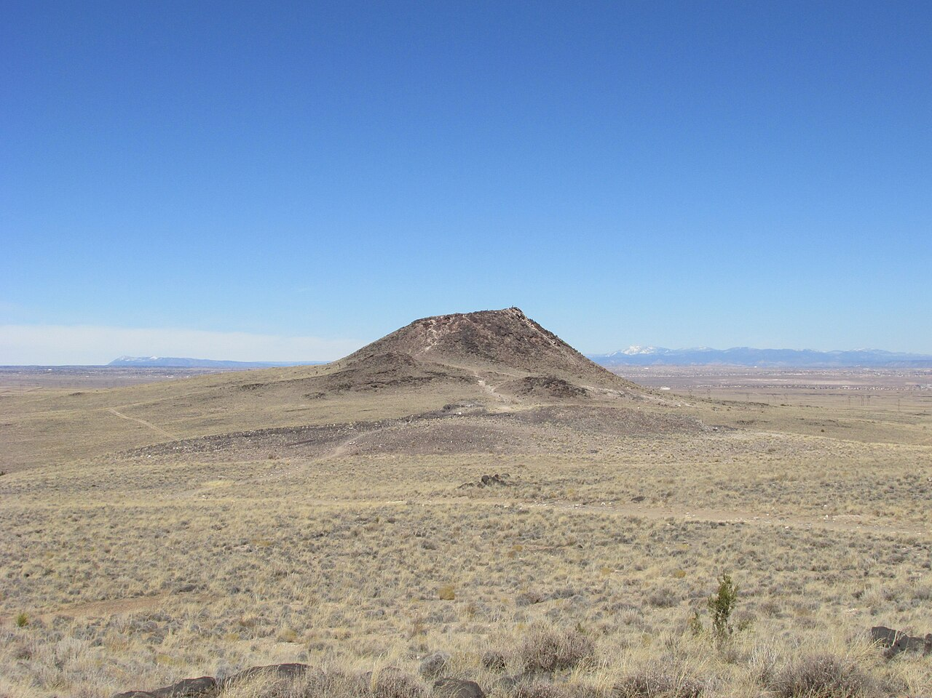

Slide 36
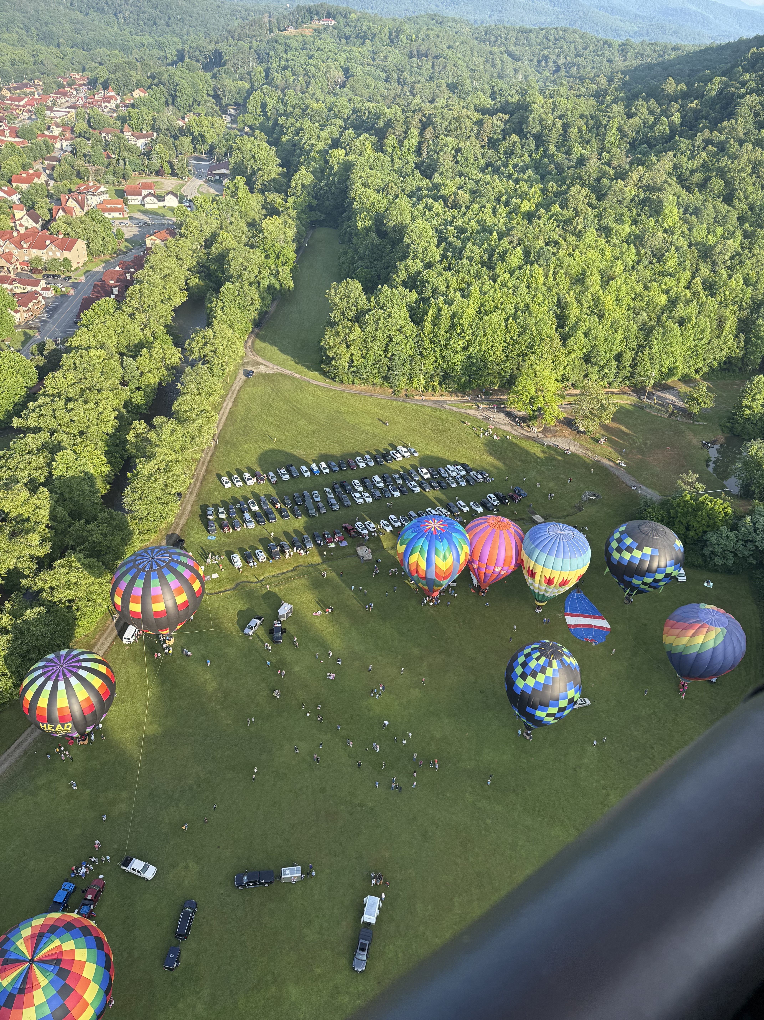

Slide 37
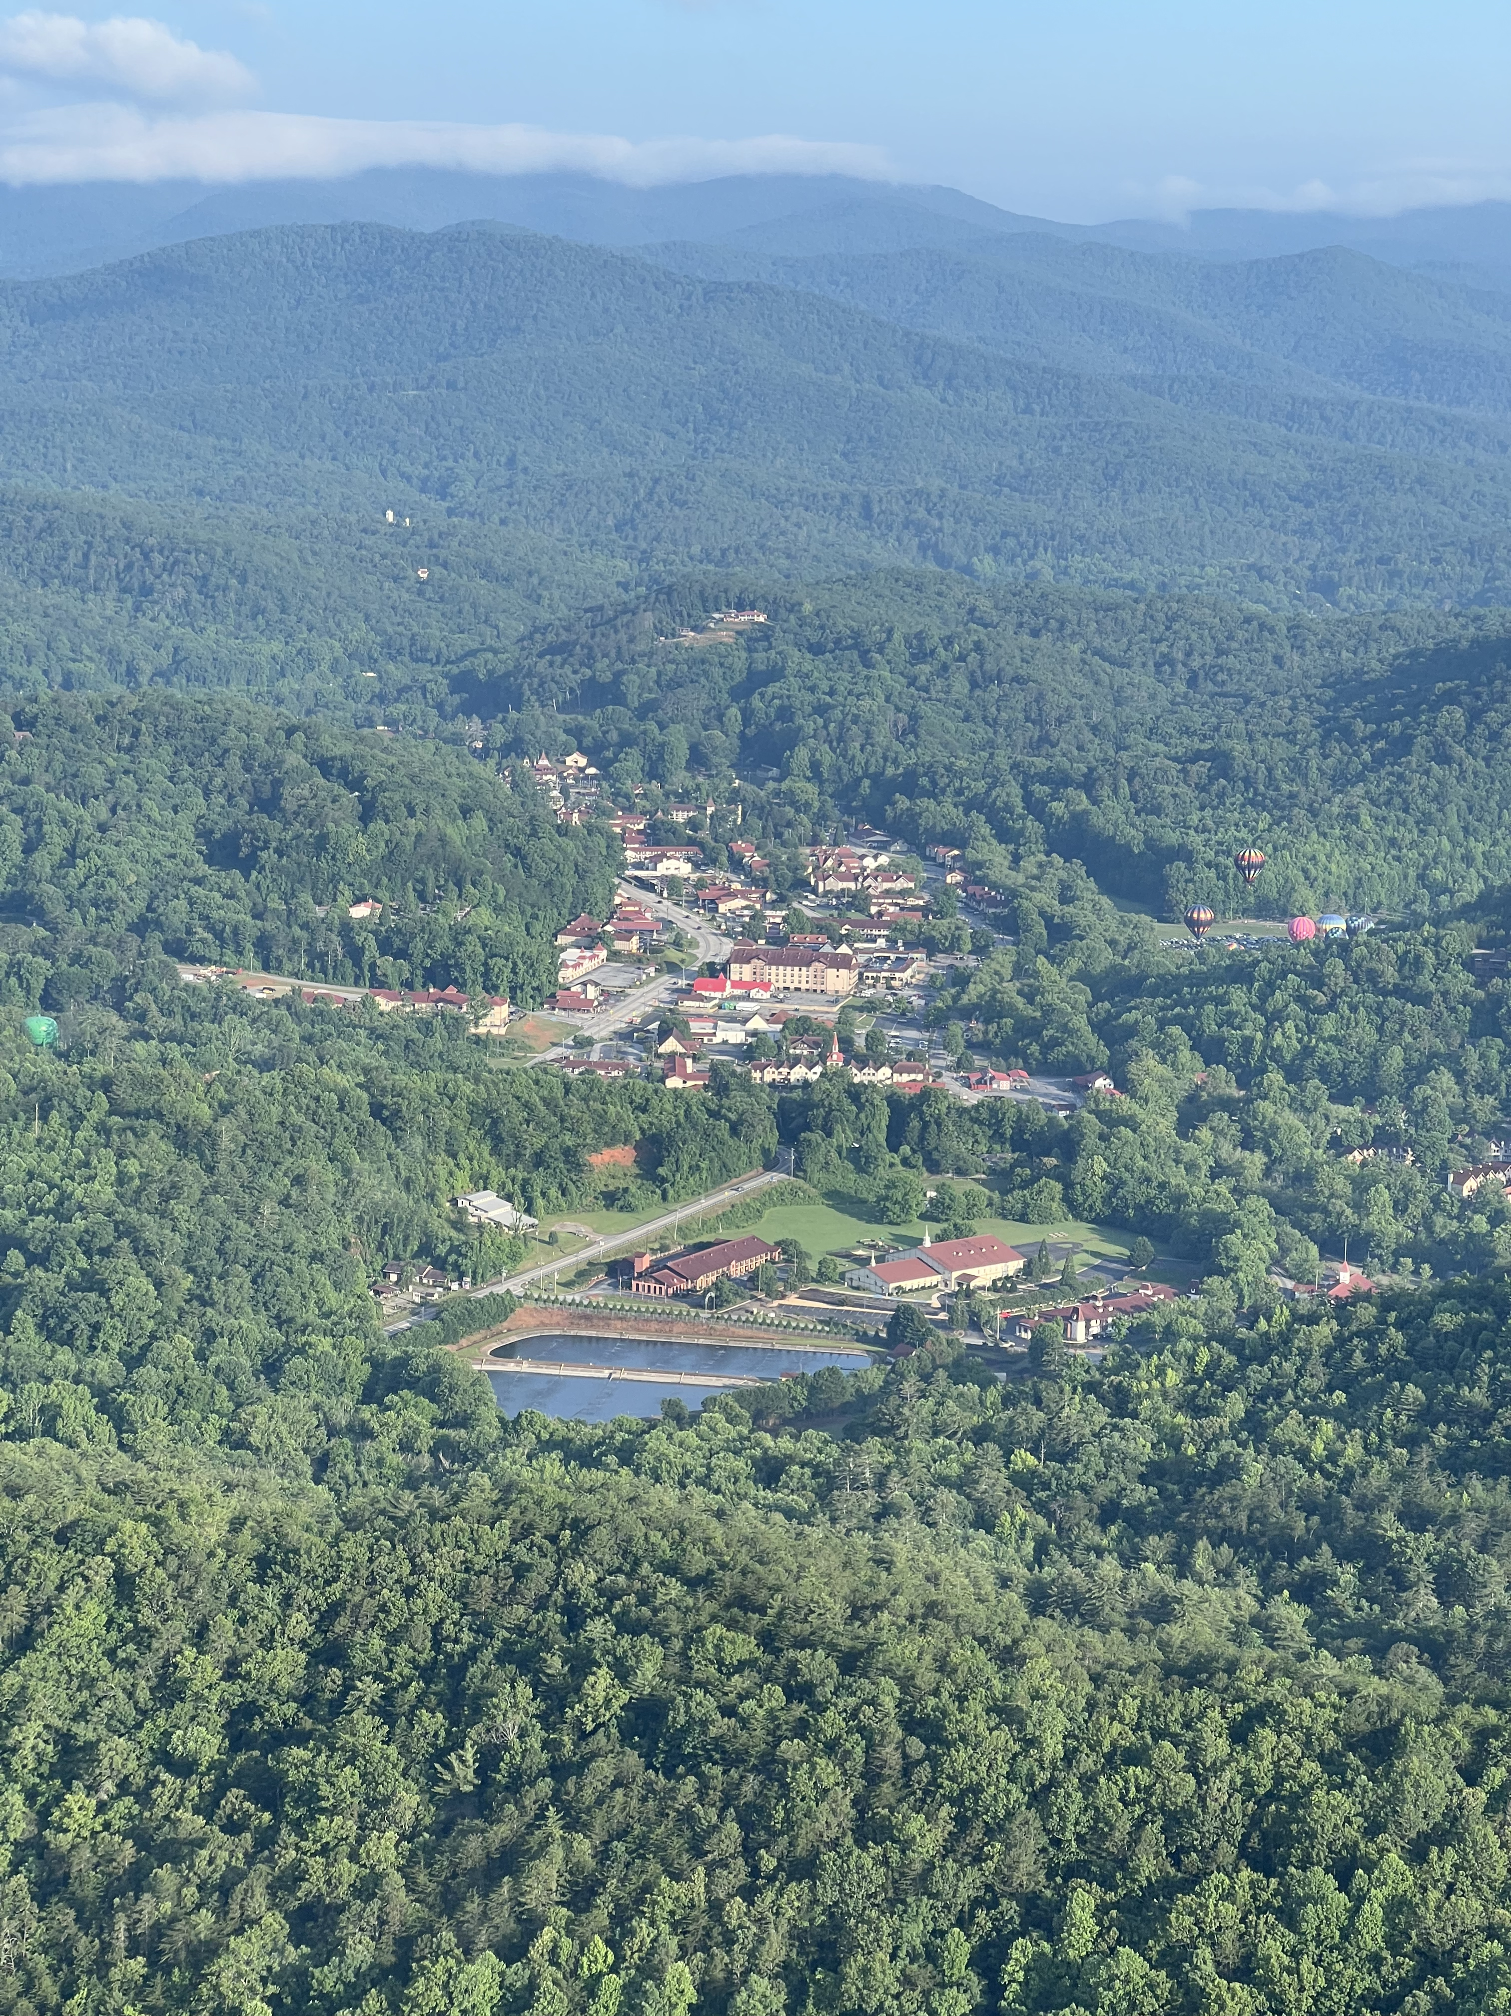

Slide 38
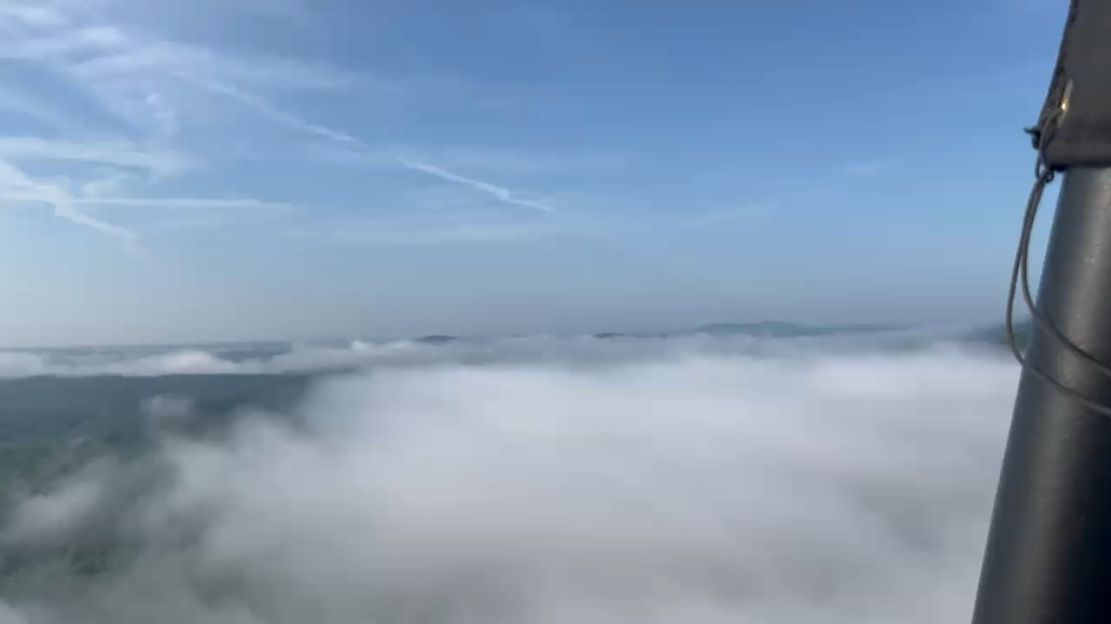
Notes:
https://www.dropbox.com/scl/fi/rn7euvgq8qbgmsjdv2jnb/2025-06-06-08.22.50.mov?rlkey=wwg19ykk0r1rfsub9vintnmqv&dl=0

Slide 39
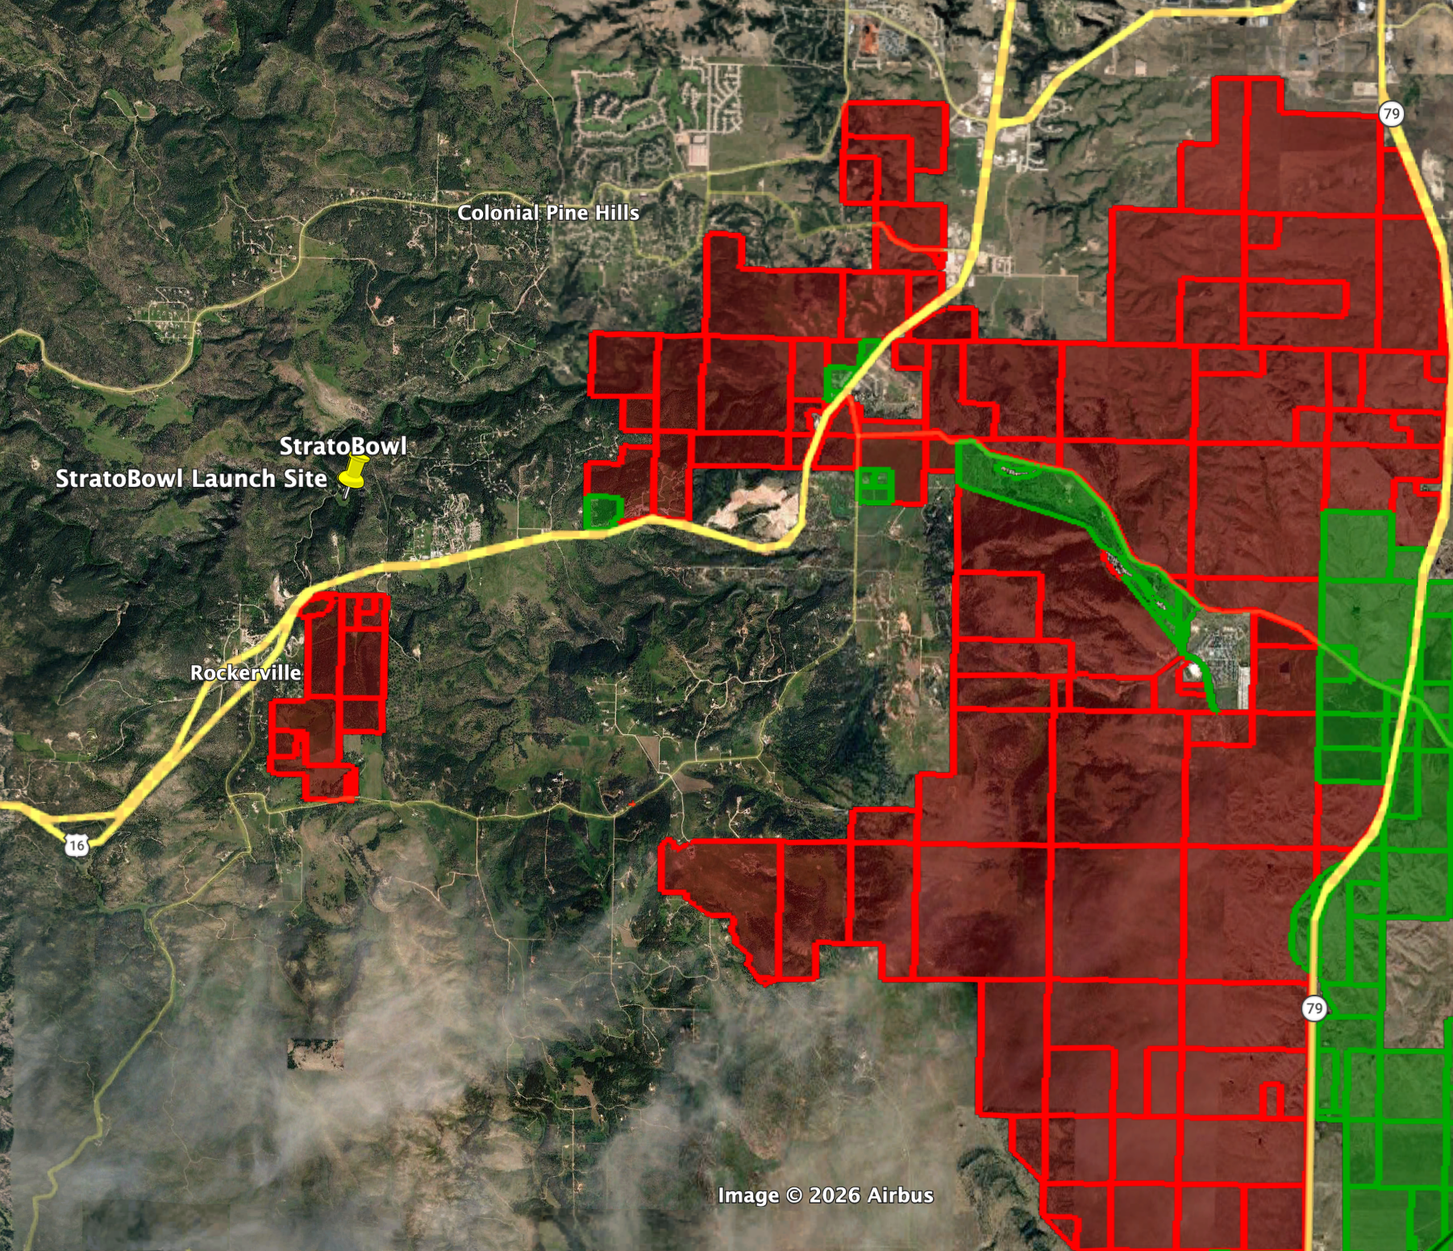

Slide 40
Today’s Agenda
Priorities for Landing
Legality of Operations
Improving Your “Legality”
Choose Your Risk

Slide 41
Most people are tolerant… Until they’re not.
Notes:
Say:
"Most landowners are reasonable… until they aren't."
Discuss cultural differences (ABQ vs Tampa).
Discuss ownership changes.
Tolerance is not permission.

Slide 42
Research Tools
Your Flight Tracks
PZ Map
OnX Hunt
County Assessor
Ownership history

Slide 43
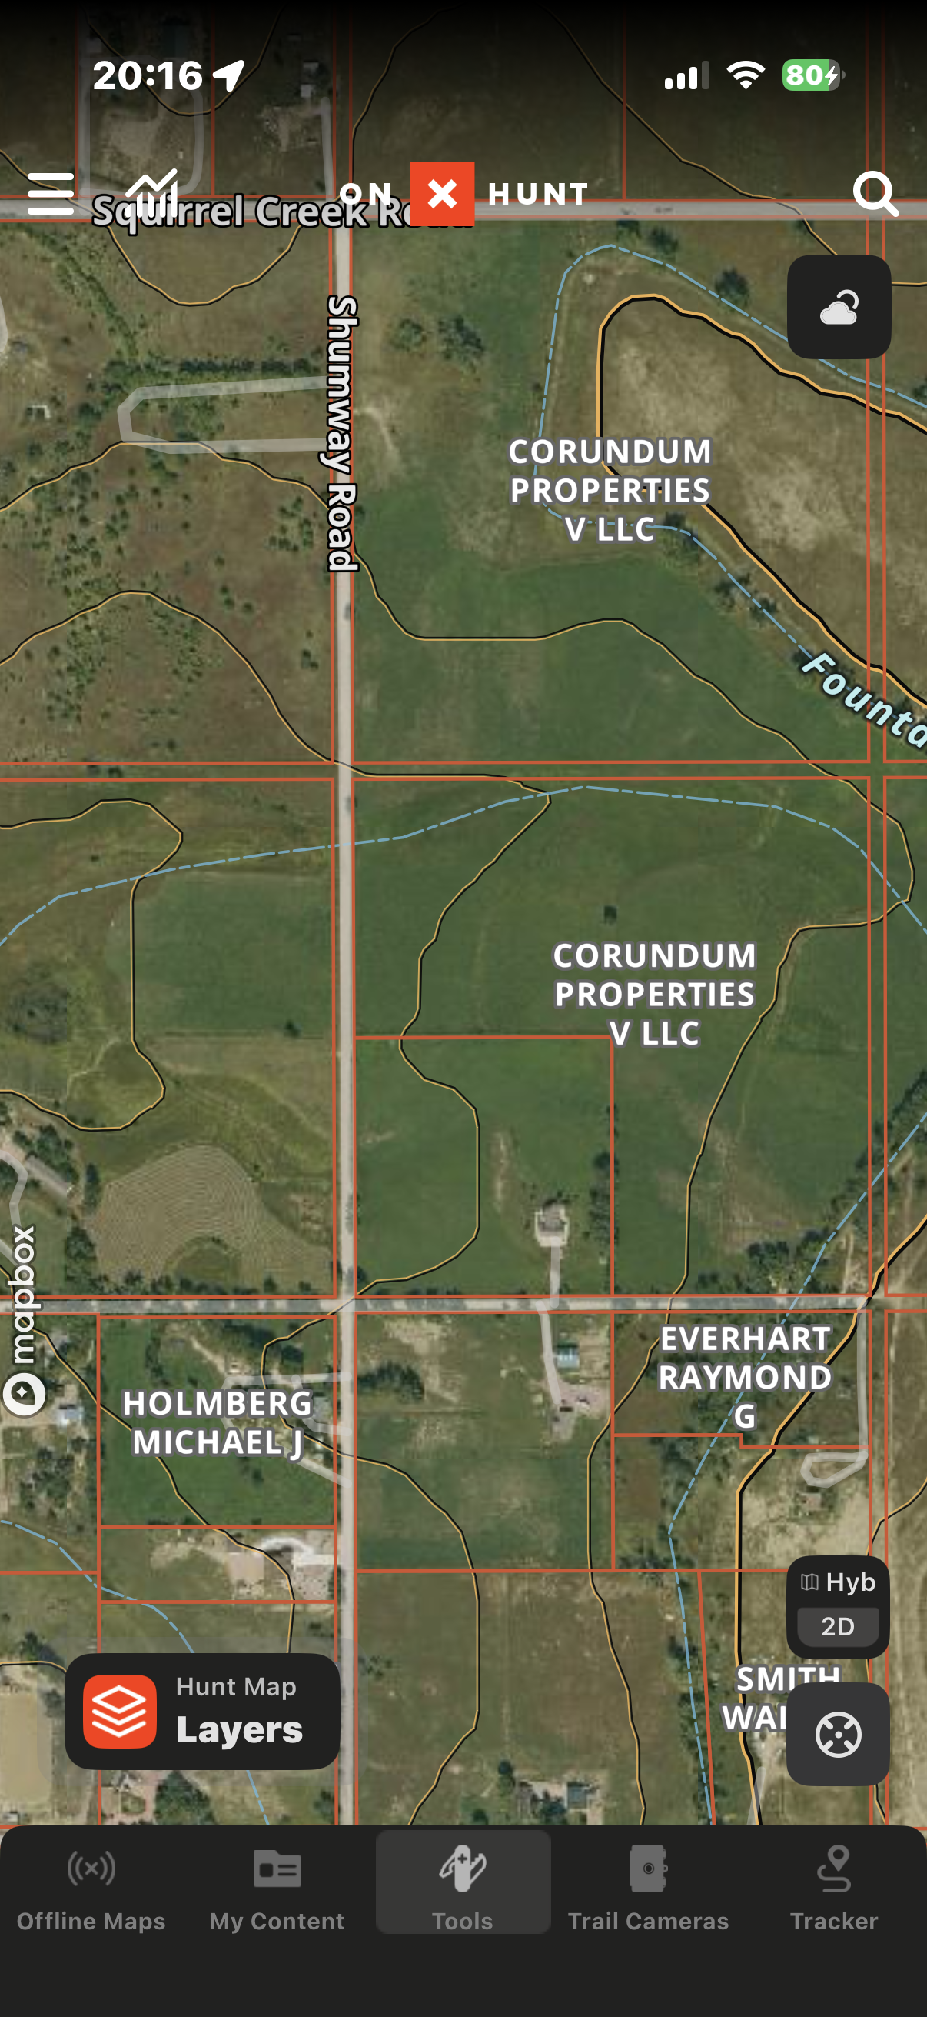
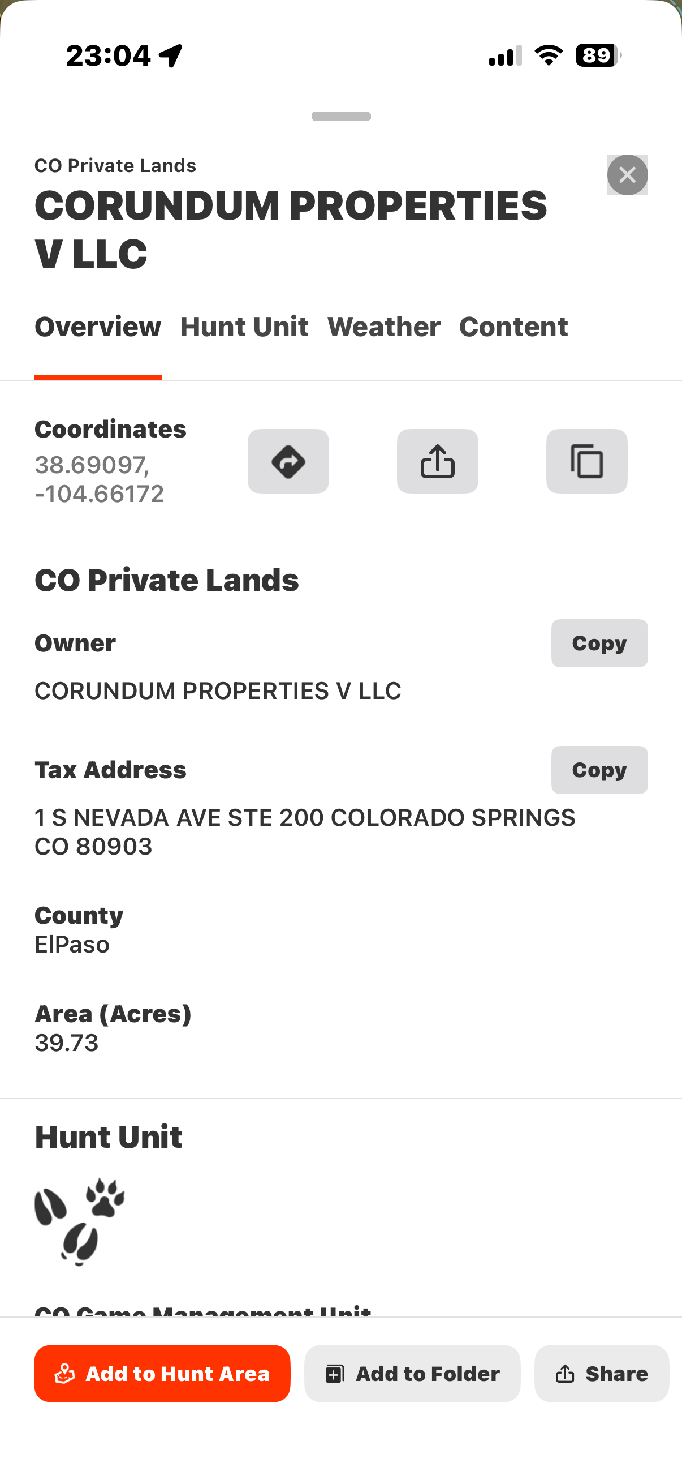
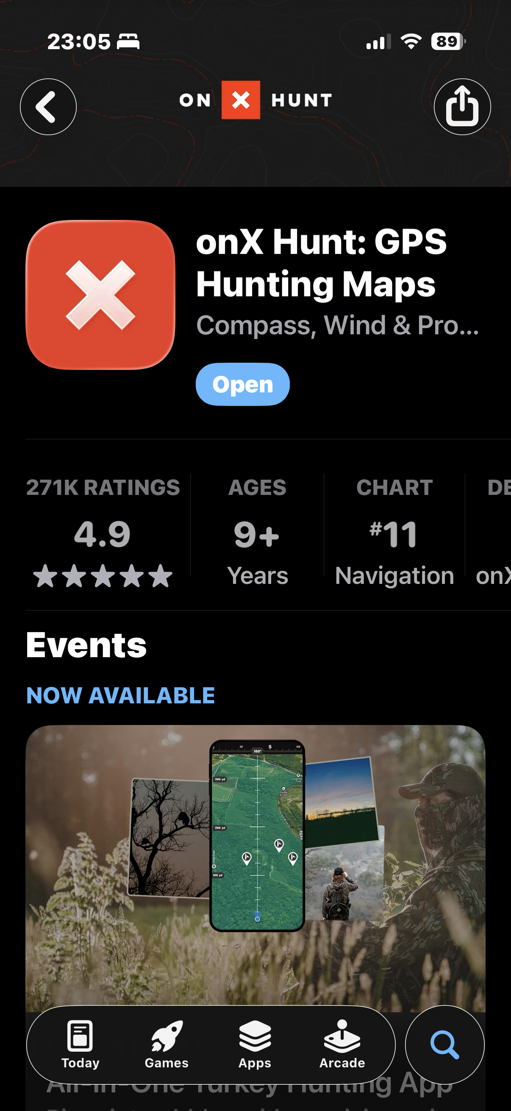
OnX Hunt - ~$35/yr with maps

Slide 44
Note About Ownership
Owners
Lessees
Renters
Managers
Etc.
All have rights

Slide 45
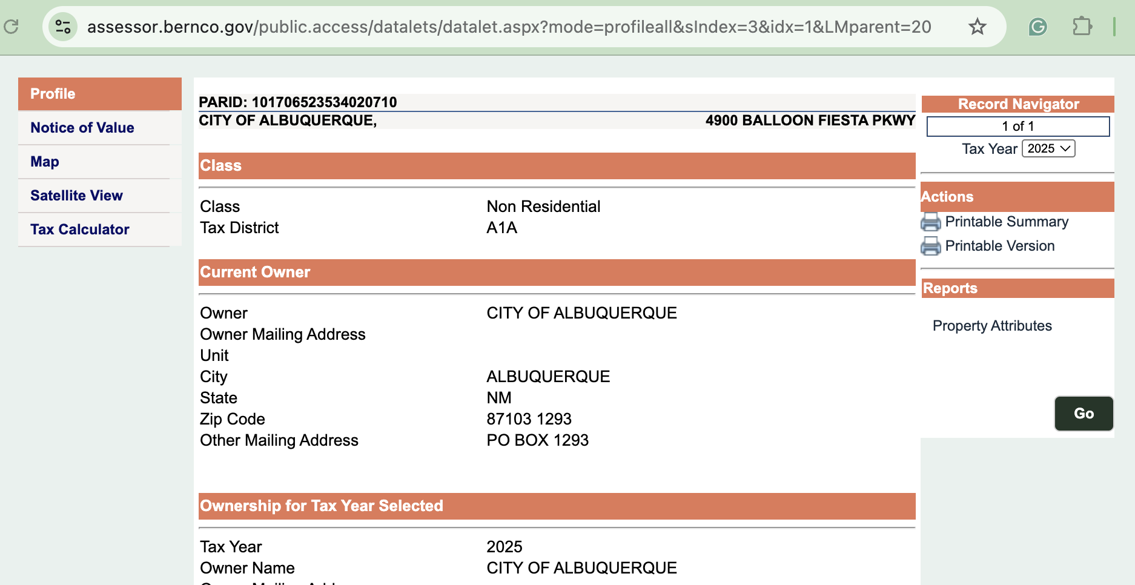
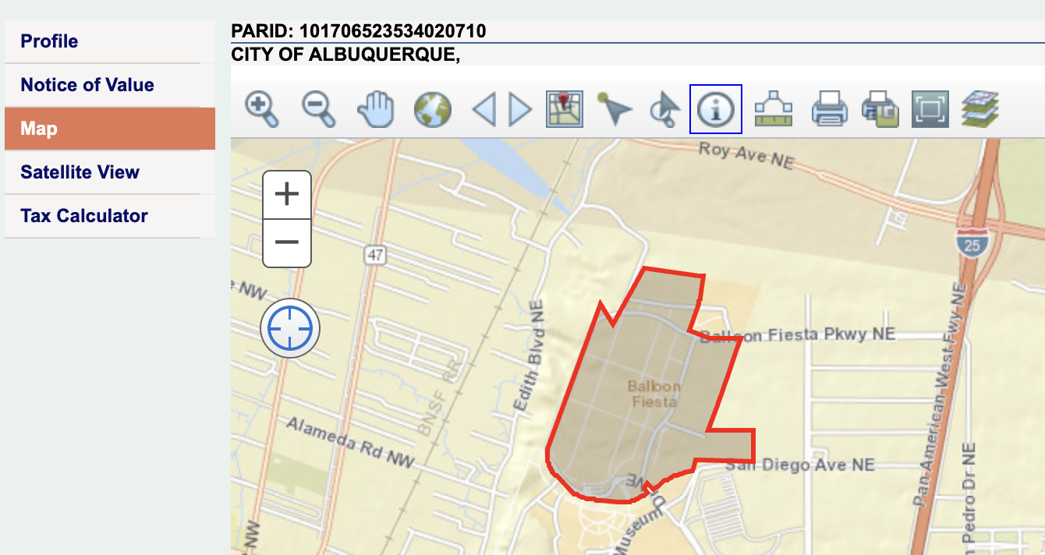
County Assessor

Slide 46
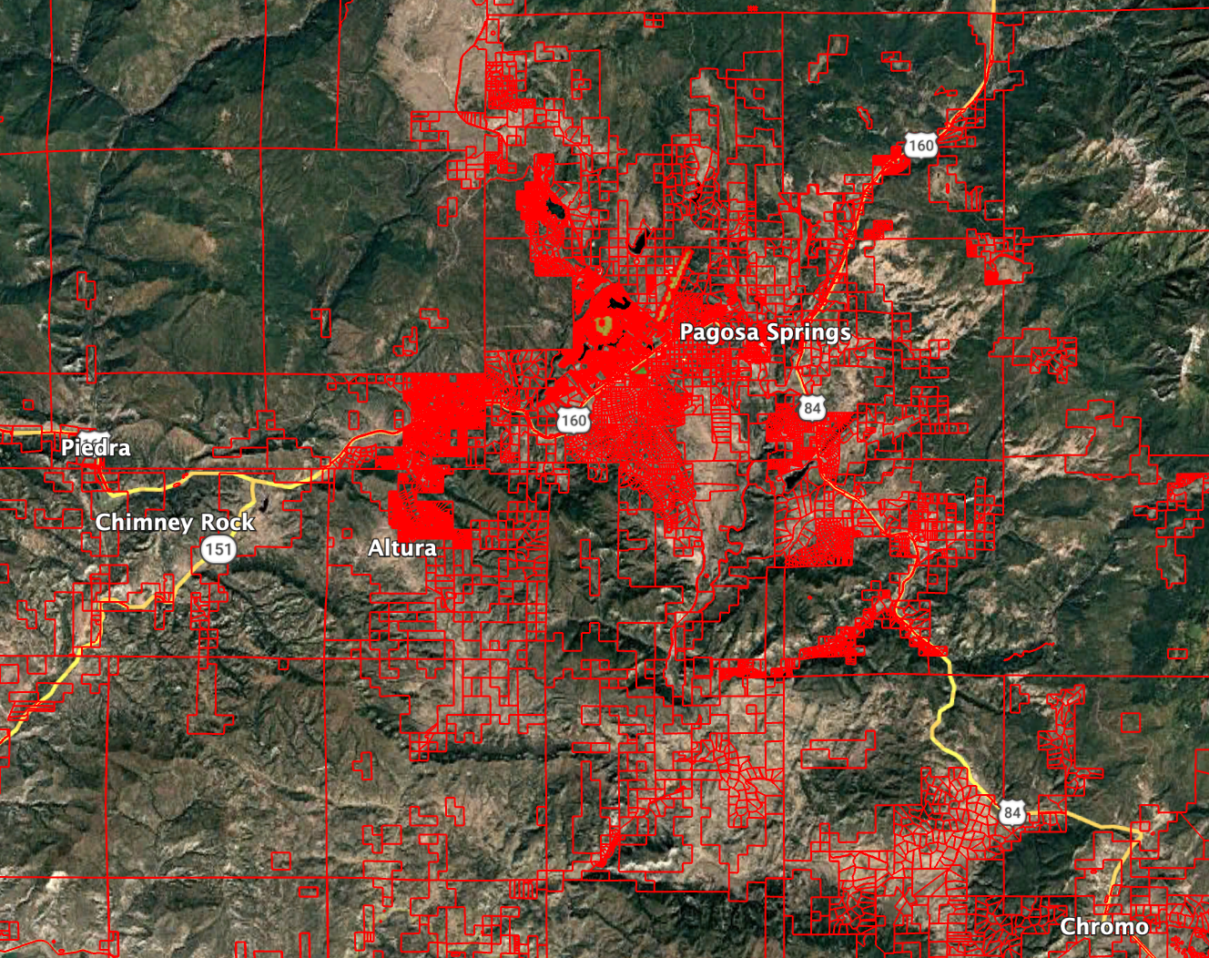
County Assessor

Slide 47
Do we learn neglect?

Slide 48
The balloon doesn’t get sued. You do.
By people…who are upset.

Slide 49
Your crew is your
legal ambassador

Slide 50
Crew Responsibilities
Ask permission respectfully
Park responsibly
Close gates
Tone matters

Slide 51
Landowner Tone
Our balloon is looking for a landing, would it be ok if we landed in your field?
We are gonna land in your field, you gotta open the gate.

Slide 52
Build Relationships
Be nice
Go back
Go ahead
Go again

Slide 53
Improving Your “Legality”
Do Your Homework
Plan Your Flight
Train Your Crew
Build Relationships

Slide 54
Take-Home #4
Relationships reduce
legal friction
Anyone can choose not to sue you

Slide 55
Updated Landing Priorities
Safety
Legal
Damage
Accessible
Aesthetic

Slide 56
I will tear up equipment to stay legal,
But I won’t tear up people.

Slide 57
Your opinion of legal will not prevent a lawsuit.

Slide 58
Would you feel confident explaining your decision?
Notes:
Let’s go back to the phone call.
“Dave… the sheriff is here.”
When that call came, I didn’t think:
‘I made a bad landing.’
I thought:
‘I made a reasonable decision.’
And that’s the uncomfortable part.
This wasn’t recklessness.
This wasn’t carelessness.
This was a decision that made sense… in the moment.
But ADM isn’t about whether something makes sense in the moment.
It’s about whether it still makes sense two years later.
Safety will always be number one.
But legal and relationship risk determines whether we get to keep flying in a place.
Your opinion of what’s legal
will not protect you from a lawsuit.
Your smooth landing
will not protect you from a lawsuit.
Your experience
will not protect you from a lawsuit.
Only thoughtful, pre-flight evaluation of legal exposure reduces that risk.
Ballooning survives on access.
Access survives on relationships.
Relationships survive on restraint.
The question isn’t just:
Can I land here?
The better question is:
If I land here…
will balloons still be welcome here in five years?
If the sheriff showed up tomorrow…
Would you feel confident explaining your decision process?
Not:
‘I’ve landed there before.’
But:
‘I evaluated safety, ownership, crop value, history, and alternatives.’
That’s Aeronautical Decision Making.
Not just wind.
Not just obstacles.
Consequences.
Thank you.

Slide 59
Can I land here? Better question: Should I?

Slide 60
What would this look like in a courtroom?

Slide 61
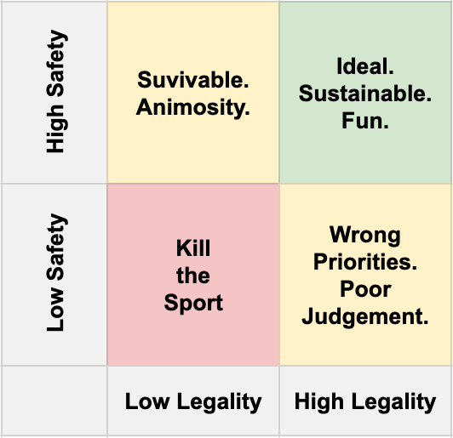
Choose Your Risk

Slide 62
Choose Your Risk
My Flight

Slide 63
Can I Land Here?
A Legal View of Aeronautical Decision Making
Dave Bair
Feb 28. 2026

